Slide 1


Slide 2
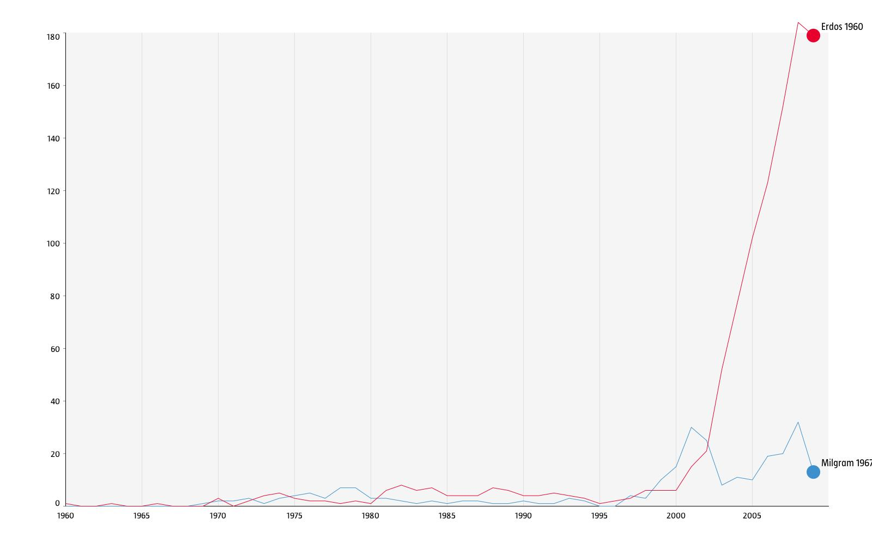
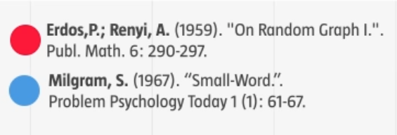
NETWORK SCIENCE The science of the 21st century
Times
cited
Years
Network Science: Introduction January 10, 2011

Slide 3
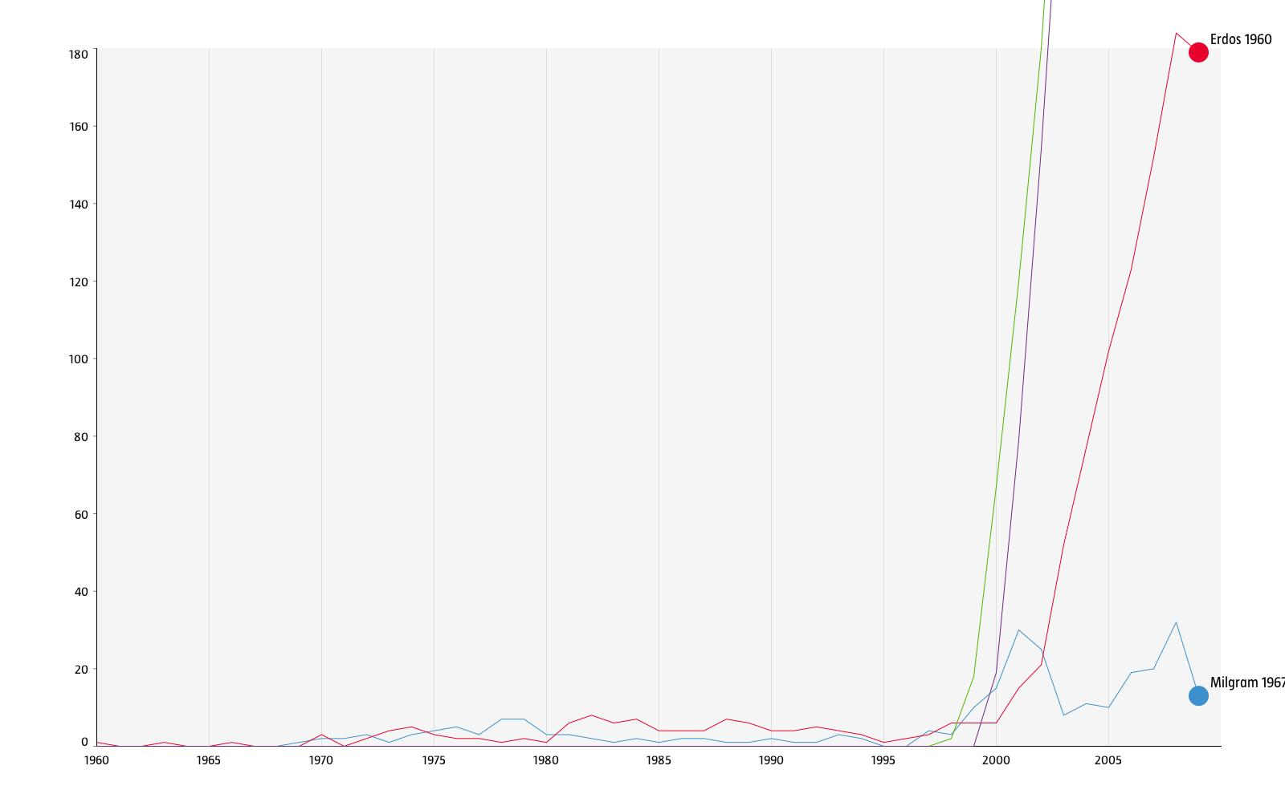
NETWORK SCIENCE The science of the 21st century
Times
cited
Years
Network Science: Introduction January 10, 2011

Slide 4
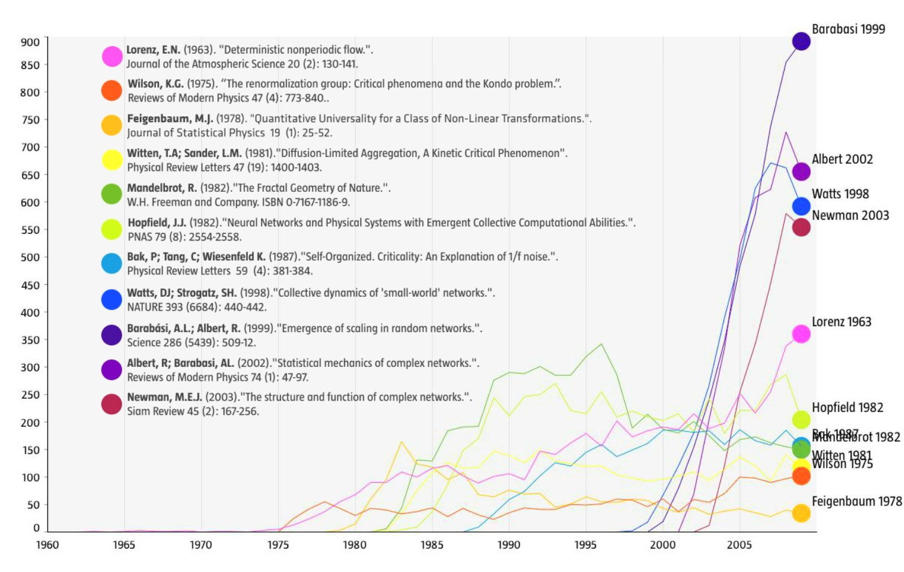
NETWORK SCIENCE The science of the 21st century
Times
cited
Years
Network Science: Introduction January 10, 2011

Slide 5
NETWORK SCIENCE The science of the 21st century
Why now?
Network Science: Introduction January 10, 2011

Slide 6
THE EMERGENCE OF NETWORK SCIENCE
Data Availability:
Movie Actor Network, 1998;
World Wide Web, 1999.
C elegans neural wiring diagram 1990
Citation Network, 1998
Metabolic Network, 2000;
PPI network, 2001
Universality:
The architecture of networks emerging in various domains of science, nature, and technology are more similar to each other than one would have expected.
The (urgent) need to understand complexity:
Despite the challenges complex systems offer us, we cannot afford to not address their behavior, a view increasingly shared both by scientists and policy makers. Networks are not only essential for this journey, but during the past decade some of the most important advances towards understanding complexity were provided in context of network theory.
Network Science: Introduction January 10, 2011

Slide 7
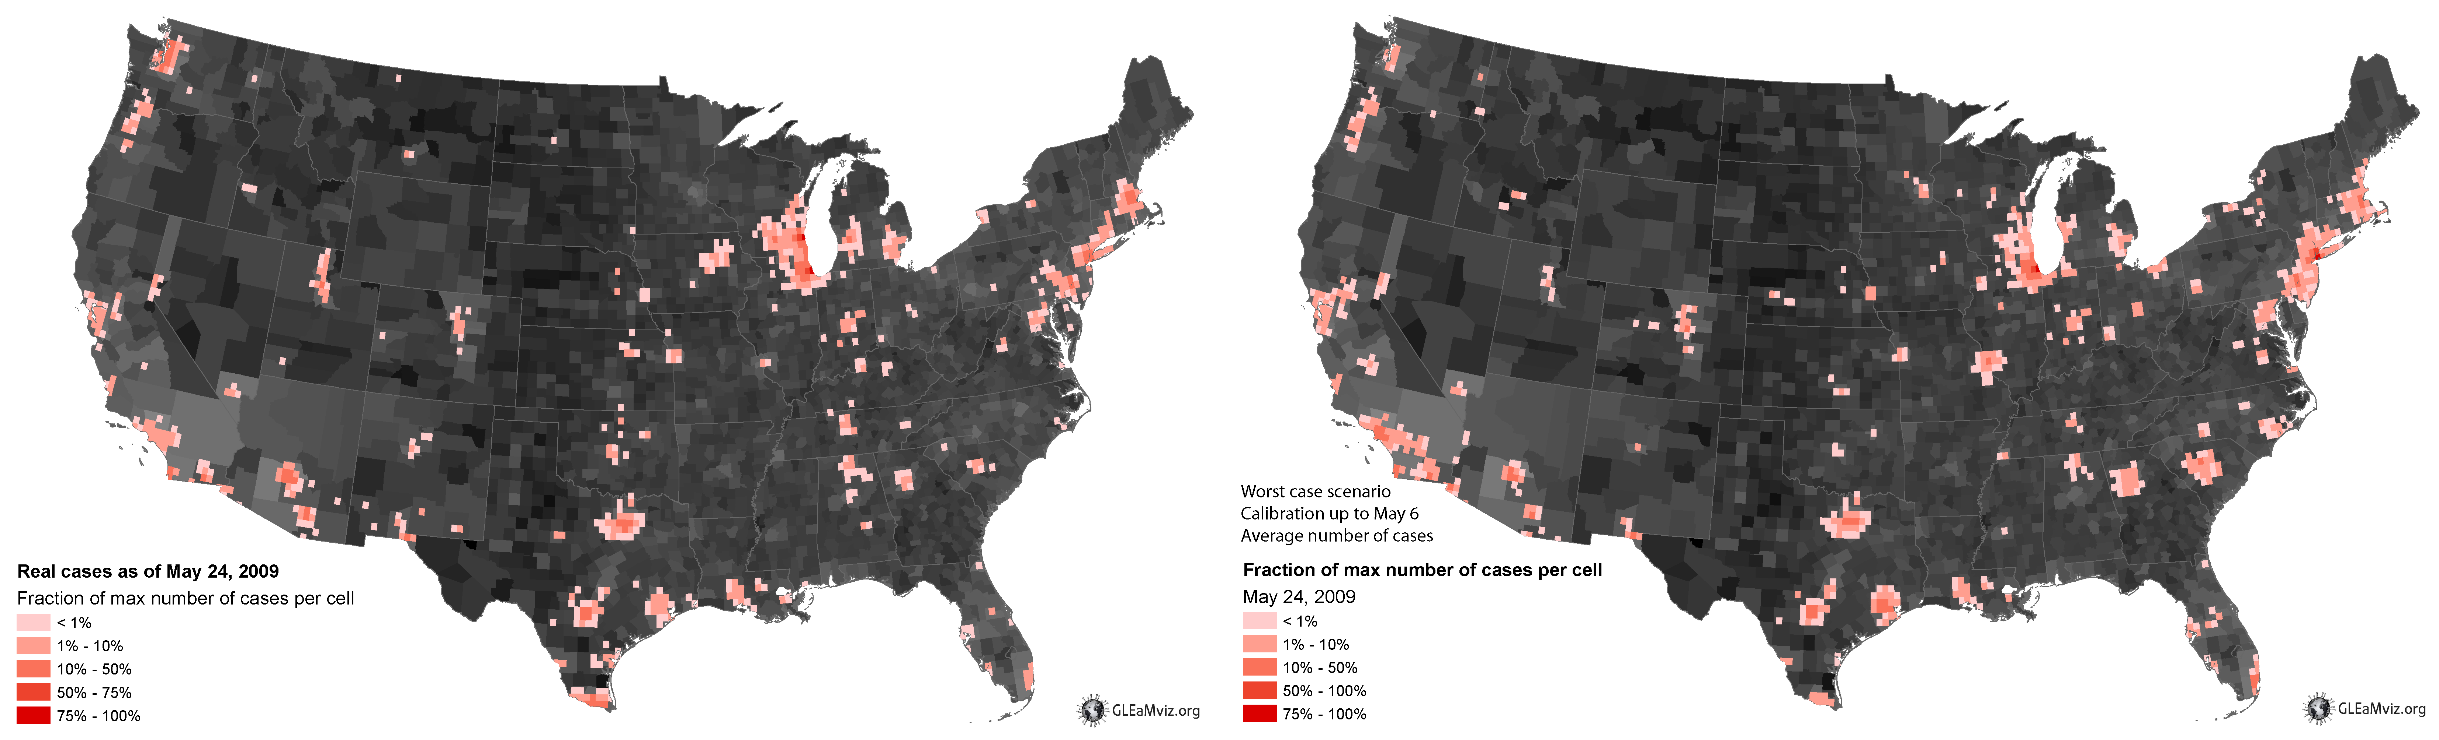
EPIDEMIC FORECAST Predicting the H1N1 pandemic
Real
Projected
Network Science: Introduction January 10, 2011

Slide 8

Thex
DOCUMENTARY
Network Science: Introduction January 10, 2011

Slide 9
Graph theory and basic terminology
Learning the language
Network Science: Graph Theory January 24, 2011

Slide 10
COMPONENTS OF A COMPLEX SYSTEM
components: nodes, vertices N
interactions: links, edges L
system: network, graph (N,L)
Network Science: Graph Theory January 24, 2011

Slide 11
NETWORKS OR GRAPHS?
network often refers to real systems
www,
social network
metabolic network.
Language: (Network, node, link)
graph: mathematical representation of a network
web graph,
social graph (a Facebook term)
Language: (Graph, vertex, edge)
We will try to make this distinction whenever it is appropriate, but in most cases we will use the two terms interchangeably.
Network Science: Graph Theory January 24, 2011

Slide 12
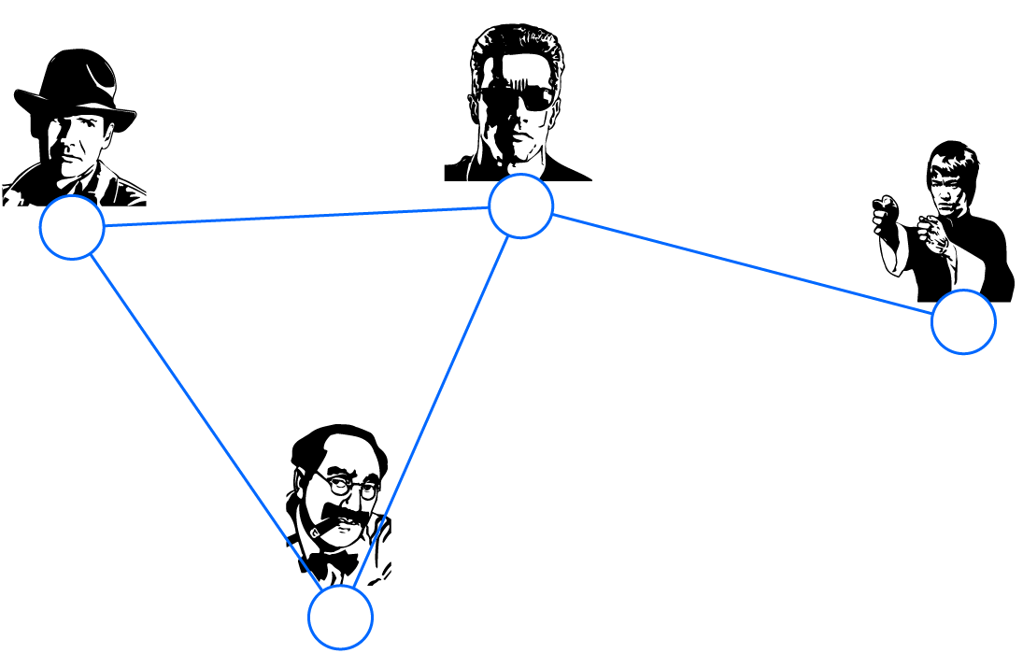

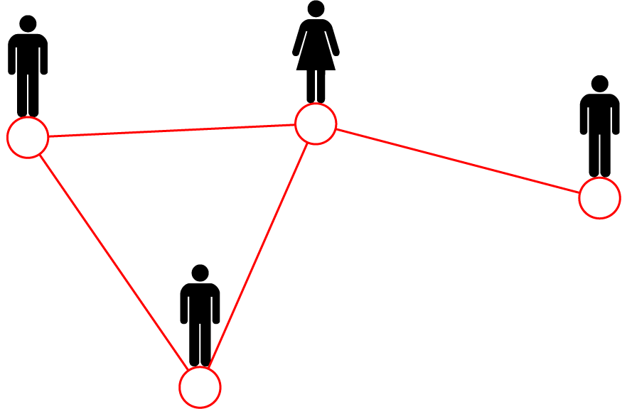
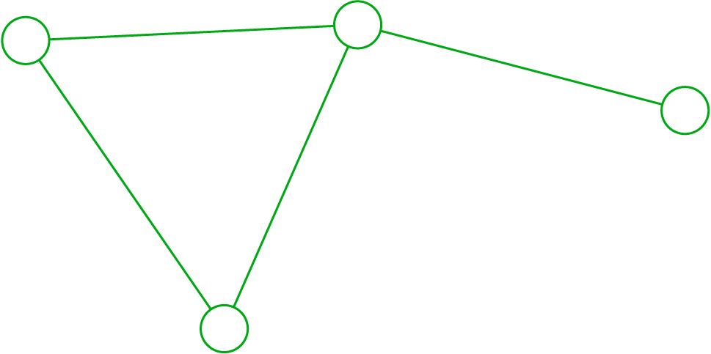
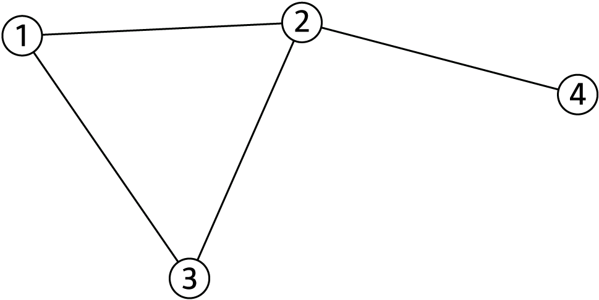
A COMMON LANGUAGE
friend
Movie 1
Mary
co-worker
Actor 2
Peter
Actor 1
Albert
Movie 3
Actor 4
brothers
friend
Movie 2
Albert
Actor 3
Protein 1
Protein 2
Protein 5
N=4
L=4
Protein 9
Network Science: Graph Theory January 24, 2011

Slide 13
CHOOSING A PROPER REPRESENTATION
The choice of the proper network representation determines our ability to use network theory successfully.
In some cases there is a unique, unambiguous representation.
In other cases, the representation is by no means unique.
For example, for a group of individuals, the way you assign the links will determine the nature of the question you can study.
Network Science: Graph Theory January 24, 2011

Slide 14
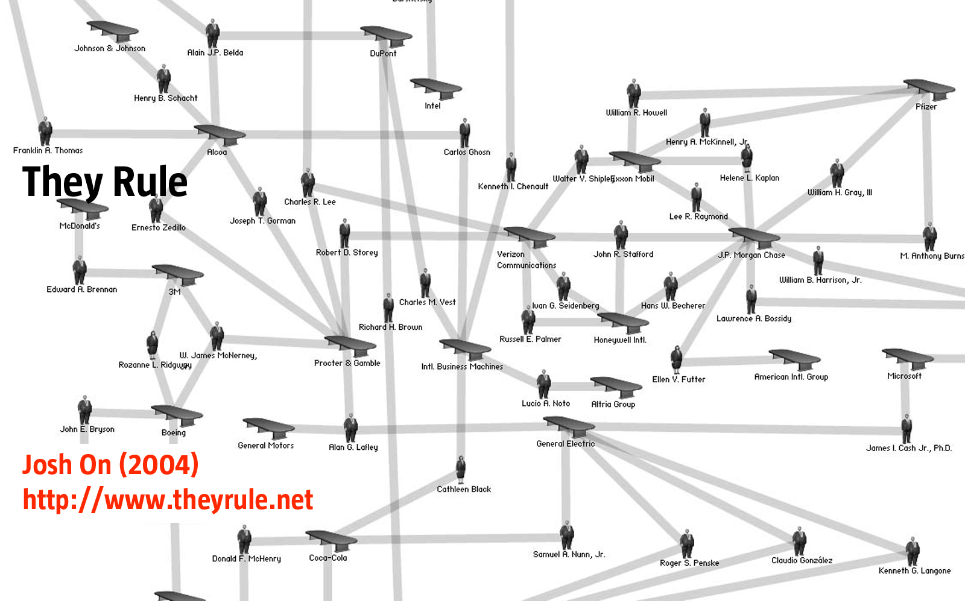
CHOOSING A PROPER REPRESENTATION
If you connect individuals that work with each other, you will explore
the professional network.
Network Science: Graph Theory January 24, 2011

Slide 15
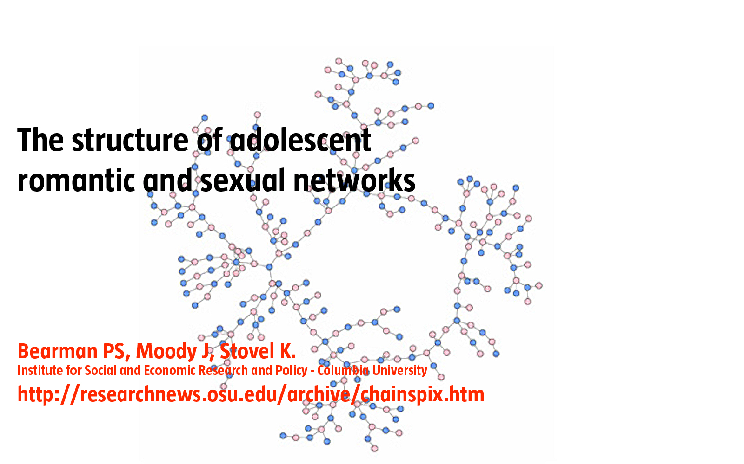
CHOOSING A PROPER REPRESENTATION
If you connect those that have a sexual relationship, you will be exploring the sexual networks.
Network Science: Graph Theory January 24, 2011

Slide 16
CHOOSING A PROPER REPRESENTATION
If you connect individuals based on their first name (all Peters connected to each other), you will be exploring what?
It is a network, nevertheless.
Network Science: Graph Theory January 24, 2011

Slide 17

Network Science: Graph Theory January 24, 2011

Slide 18
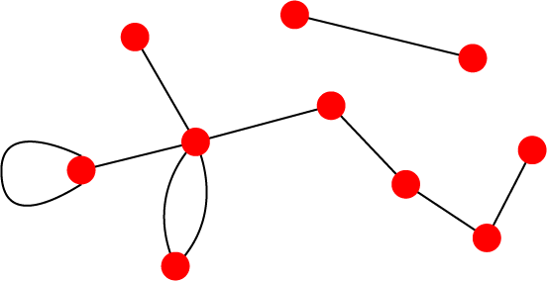
UNDIRECTED VS. DIRECTED NETWORKS
Undirected
Directed
Links: undirected (symmetrical)
Graph:
Links: directed (arcs).
Digraph = directed graph:
L
A
D
F
M
B
An undirected link is the superposition of two opposite directed links.
C
I
D
B
G
E
G
H
A
C
F
Undirected links :
coauthorship links
Actor network
protein interactions
Directed links :
URLs on the www
phone calls
metabolic reactions
Network Science: Graph Theory January 24, 2011

Slide 19
ADJACENCY MATRIX
4
4
3
2
3
2
1
1
A_{ij}=1 if there is a link between node i and j
A_{ij}=0 if nodes i and j are not connected to each other.
Note that for a directed graph (right) the matrix is not symmetric.
Network Science: Graph Theory January 24, 2011

Slide 20
ADJACENCY MATRIX
a
e
a b c d e f g h
a 0 1 0 0 1 0 1 0
b 1 0 1 0 0 0 0 1
c 0 1 0 1 0 1 1 0
d 0 0 1 0 1 0 0 0
e 1 0 0 1 0 0 0 0
f 0 0 1 0 0 0 1 0
g 1 0 1 0 0 0 0 0
h 0 1 0 0 0 0 0 0
h
b
d
f
g
c
Network Science: Graph Theory January 24, 2011
Notes:
The adjacency matrix can take far more complicated forms for a larger network….

Slide 21
NODE DEGREES
Node degree: the number of links connected to the node.
Undirected
j
i
4
2
3
1
Network Science: Graph Theory January 24, 2011

Slide 22
NODE DEGREES
In directed networks we can define an in-degree and out-degree. The (total) degree is the sum of in- and out-degree.
Source: a node with k^{in}= 0; Sink: a node with k^{out}= 0.
B
D
Directed
C
G
E
A
F
4
2
3
1

Slide 23
A BIT OF STATISTICS
We have a sample of values x1, ..., xN
Average (a.k.a. mean): typical value
<x> = (x1 + x1 + ... + xN)/N = Σi xi /N
Standard deviation: fluctuations around typical value
σx = √Σi (xi - <x>)²/N
Network Science: Graph Theory January 24, 2011

Slide 24
AVERAGE DEGREE
j
Undirected
i
N – the number of nodes in the graph
B
D
Directed
C
E
A
F
Network Science: Graph Theory January 24, 2011

Slide 25
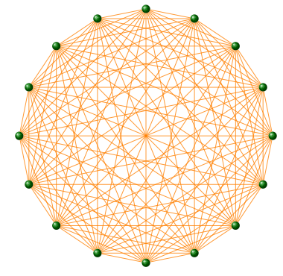
COMPLETE GRAPH
The maximum number of links a network
of N nodes can have is:
A graph with degree L=L_{max} is called a complete graph,
and its average degree is <k>=N-1
Network Science: Graph Theory January 24, 2011

Slide 26
SPARSE GRAPH
Most networks observed in real systems are sparse:
L << L_{max} (or <k> <<N-1).
WWW (ND Sample): N=325,729; <k>=4.51
Protein (S. Cerevisiae): N=1870; <k>=2.39
Coauthorship (Math): N=70 975; <k>=3.9
Movie Actors: N=212 250; <k>=28.78
(Source: Albert, Barabasi, RMP2002)
Consequence: Their adjacency matrix is filled with zeros!
Network Science: Graph Theory January 24, 2011

Slide 27




Bacon 1
ACTOR NETWORK
Austin Powers: The spy who shagged me
Let’s make it legal
Robert Wagner
Wild Things
What Price Glory
Barry Norton
A Few Good Men
Monsieur Verdoux
Notes:
Erdos can be also connected to Kevin Bacon.
Erdos plaid with Gene Paterson, in N is a Number (1993).
Who played with Sam Rockwell (Box of Moonlight, 1996).
Who palyed with Kevin Bacon in Frost/Nixon (2008)
What is my Bacon number, what do you think? recent documentary that was eared on Discovery channel, called Connected (2009).

Slide 28


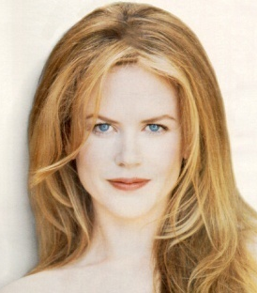
Actors
ACTOR NETWORK
Nodes: actors
Links: cast jointly
Days of Thunder (1990) Far and Away (1992) Eyes Wide Shut (1999)
N = 212,250 actors ⟨k⟩ =28.78
Network Science: Graph Theory January 24, 2011

Slide 29
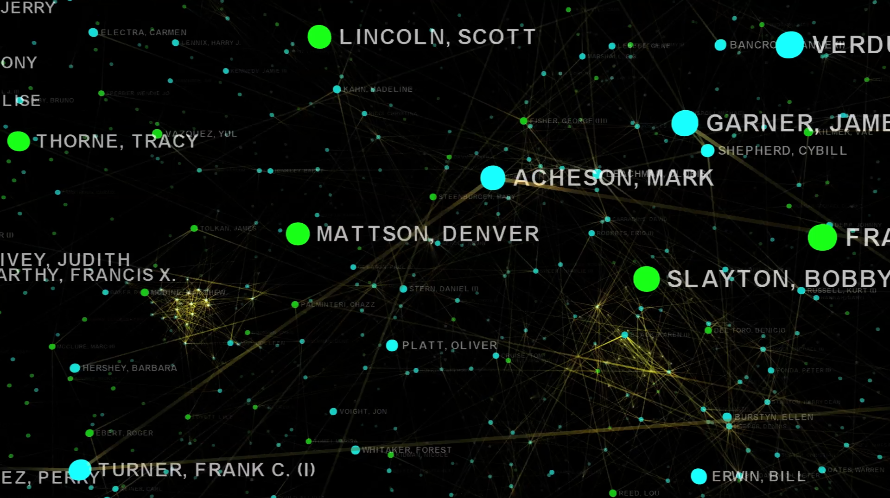
IMBD SCALE FREE
Network Science: Graph Theory January 24, 2011
Notes:
let us get a feeling of how a sparse networks looks like...

Slide 30

Network Science: Graph Theory January 24, 2011

Slide 31
GRAPHOLOGY
1
Undirected
Directed
4
4
1
1
2
2
3
3
Actor network, protein-protein interactions
WWW, citation networks
Network Science: Graph Theory January 24, 2011

Slide 32
GRAPHOLOGY
2
Unweighted
(undirected)
Weighted
(undirected)
4
4
1
1
2
2
3
3
protein-protein interactions, www
Call Graph, metabolic networks
Network Science: Graph Theory January 24, 2011

Slide 33
GRAPHOLOGY
3
Self-interactions
Multigraph
(undirected)
4
4
1
1
2
2
3
3
Protein interaction network, www
Social networks, collaboration networks
Network Science: Graph Theory January 24, 2011

Slide 34
GRAPHOLOGY
4
Complete Graph
(undirected)
4
1
2
3
Actor network, protein-protein interactions
Network Science: Graph Theory January 24, 2011

Slide 35
GRAPHOLOGY
X
WWW >
Protein Interactions >
Protein Complex >
Collaboration network >
Mobile phone calls >
Facebook Friendship links >
> directed multigraph with self-interactions
> undirected unweighted with self-interactions
> unweighted complete graph with self-interactions
> undirected multigraph or weighted.
> directed, weighted.
> undirected, unweighted.
Network Science: Graph Theory January 24, 2011

Slide 36
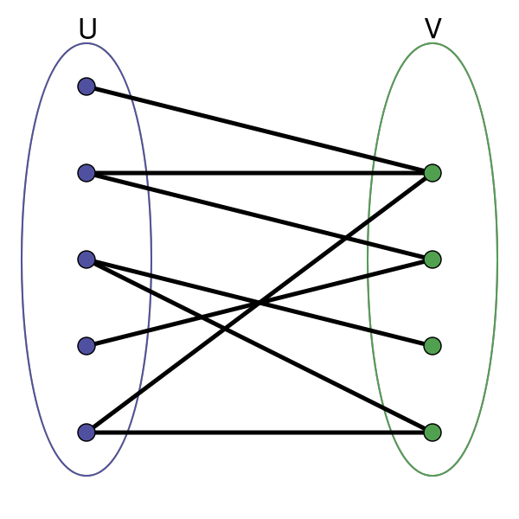
BIPARTITE GRAPHS
bipartite graph (or bigraph) is a graph whose nodes can be divided into two disjoint sets U and V such that every link connects a node in U to one in V; that is, U and V are independent sets.
Examples:
Hollywood actor network
Collaboration networks
Disease network (diseasome)
Network Science: Graph Theory January 24, 2011

Slide 37
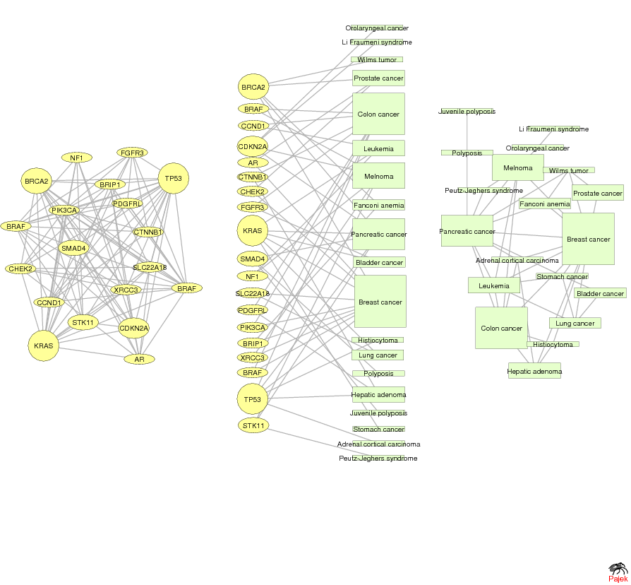
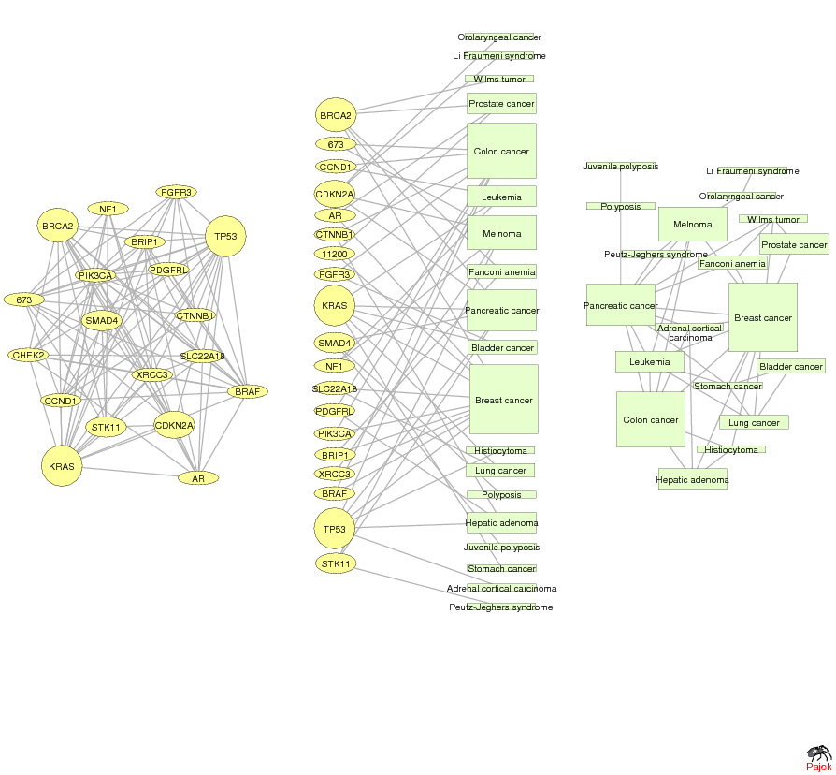
GENE NETWORK – DISEASE NETWORK
DISEASOME
PHENOME
GENOME
Gene network
Disease network
Goh, Cusick, Valle, Childs, Vidal & Barabási, PNAS (2007)
Network Science: Graph Theory January 24, 2011

Slide 38
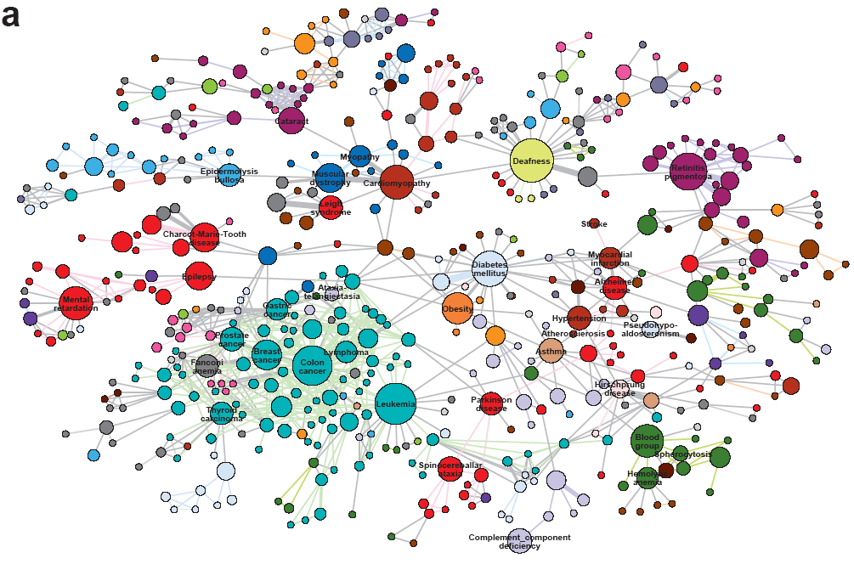
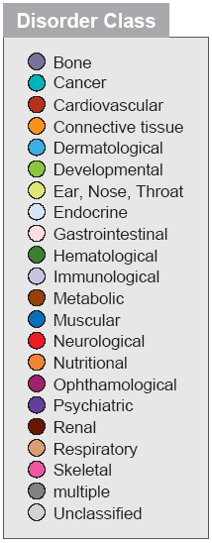
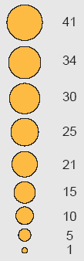
HUMAN DISEASE NETWORK

Slide 39

Network Science: Graph Theory January 24, 2011

Slide 40
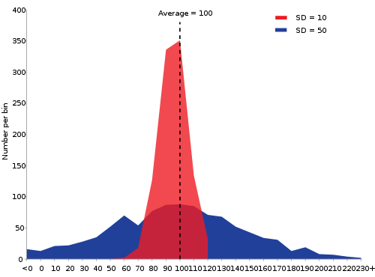
STATISTICS REMINDER
We have a sample of values x1, ..., xN
Distribution of x (a.k.a. PDF): probability that a randomly chosen value is x P(x) = (# values x) / N Σi P(xi) = 1 always!
Histograms >>>
Network Science: Graph Theory January 24, 2011

Slide 41

DEGREE DISTRIBUTION
Degree distribution P(k): probability that a randomly chosen vertex has degree k
Nk = # nodes with degree k
P(k) = Nk / N ➔ plot
P(k)
0.6
0.5
0.4
0.3
0.2
0.1
1
2
3
4
k
Network Science: Graph Theory January 24, 2011

Slide 42
DEGREE DISTRIBUTION
discrete representation: p_{k} is the probability that a node has degree k.
continuum description: P(k) is the pdf of the degrees, where
represents the probability that a node’s degree is between k₁ and k₂.
Normalization condition:
, where K_{min} is the minimal degree in the network.
Network Science: Graph Theory January 24, 2011

Slide 43

Network Science: Graph Theory January 24, 2011

Slide 44
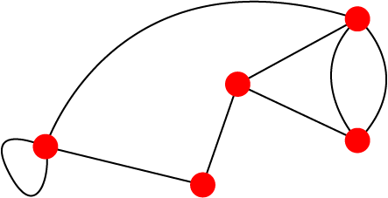
PATHS
A path is a sequence of nodes in which each node is adjacent to the next one
P_{i0,in} of length n between nodes i₀ and i_{n} is an ordered collection of n+1 nodes and n links
B
A path can intersect itself and pass through the same link repeatedly. Each time a link is crossed, it is counted separately
A legitimate path on the graph on the right: ABCBCADEEBA
In a directed network, the path can follow only the direction of an arrow.
A
E
C
D
Network Science: Graph Theory January 24, 2011

Slide 45
NUMBER OF PATHS BETWEEN TWO NODES Adjacency Matrix
N_{ij},number of paths between any two nodes i and j:
Length n=1: If there is a link between i and j, then A_{ij}=1 and A_{ij}=0 otherwise.
Length n=2: If there is a path of length two between i and j, then A_{ik}A_{kj}=1, and A_{ik}A_{kj}=0 otherwise.
The number of paths of length 2:
Length n: In general, if there is a path of length n between i and j, then A_{ik}…A_{lj}=1 and A_{ik}…A_{lj}=0 otherwise.
The number of paths of length n between i and j is*
*holds for both directed and undirected networks.
Network Science: Graph Theory January 24, 2011

Slide 46
DISTANCE IN A GRAPH Shortest Path, Geodesic Path
The distance (shortest path, geodesic path) between two nodes is defined as the number of edges along the shortest path connecting them.
*If the two nodes are disconnected, the distance is infinity.
In directed graphs each path needs to follow the direction of the arrows.
Thus in a digraph the distance from node A to B (on an AB path) is generally different from the distance from node B to A (on a BCA path).
B
A
C
D
B
A
C
D
Network Science: Graph Theory January 24, 2011

Slide 47
FINDING DISTANCES: BREADTH FIRST SEATCH
Distance between node 1 and node 4:
Start at 1.
1
Network Science: Graph Theory January 24, 2011

Slide 48
FINDING DISTANCES: BREADTH FIRST SEATCH
Distance between node 1 and node 4:
Start at 1.
Find the nodes adjacent to 1. Mark them as at distance 1. Put them in a queue.
1
1
1
1
Network Science: Graph Theory January 24, 2011

Slide 49
FINDING DISTANCES: BREADTH FIRST SEATCH
Distance between node 1 and node 4:
Start at 1.
Find the nodes adjacent to 1. Mark them as at distance 1. Put them in a queue.
Take the first node out of the queue. Find the unmarked nodes adjacent to it in the graph. Mark them with the label of 2. Put them in the queue.
2
2
1
1
1
2
1
2
2
Network Science: Graph Theory January 24, 2011

Slide 50
FINDING DISTANCES: BREADTH FIRST SEARCH
Distance between node 1 and node 4:
Start at 1.
Find the nodes adjacent to 1. Mark them as at distance 1. Put them in a queue.
Take the first node out of the queue. Find the unmarked nodes adjacent to it in the graph. Mark them with the label of 2. Put them in the queue.
…
Take the first node, w, out of the queue. Find the unmarked nodes adjacent to it in the graph. Mark them with the label of w+1. Put them in the queue.
2
w
w
2
1
1
1
w+1
w+1
2
Network Science: Graph Theory January 24, 2011

Slide 51
FINDING DISTANCES: BREADTH FIRST SEATCH
Distance between node 1 and node 4:
Repeat until you find node 4 or there are no more nodes in the queue.
The distance between 1 and 4 is the label of 4 or, if 4 does not have a label, infinity.
3
3
4
2
4
3
2
1
1
1
3
4
2
4
3
3
4
1
4
3
4
4
2
2
3
Network Science: Graph Theory January 24, 2011

Slide 52
FINDING DISTANCES: BREADTH FIRST SEATCH ALGORITHM
For a weighted network, we have Dijkstra’s algorithm.
http://en.wikipedia.org/wiki/Dijkstra%27s_algorithm
Network Science: Graph Theory January 24, 2011
http://www.yaldex.com/games-programming/0672323699_ch12lev1sec7.html
Ex. Apply the algorithm to find the
distance between A and C

Slide 53
RECORDING DISTANCES
B
A B C D
A 0 l_{AB} l_{AC} l_{AD}
B l_{BA} 0 l_{BC} l_{BD}
C l_{CA} l_{CB} 0 l_{CD}
D l_{DA} l_{DB} l_{DC} 0
A
Fill out the matrix
C
D
Q: How many entries will you need for an N- node graph?
B
A
A: N(N-1) in a digraph, N(N-1)/2 in a symmetrical graph.
Let’s use the notation
C
D
Network Science: Graph Theory January 24, 2011
Notes:
The distance between a node and itself can be taken as zero, and the average distance can be taken over N^2.
Leave the two matrices on the blackboard.

Slide 54
NETWORK DIAMETER AND AVERAGE DISTANCE
Diameter: the maximum distance between any pair of nodes in the graph.
Average path length/distance for a connected graph (component) or a strongly connected (component of a) digraph.
where l_{ij} is the distance from node i to node j
In an undirected (symmetrical) graph l_{ij} =l_{ji,} we only need to count them once
Network Science: Graph Theory January 24, 2011

Slide 55
CONNECTIVITY OF UNDIRECTED GRAPHS
Connected (undirected) graph: any two vertices can be joined by a path.
A disconnected graph is made up by two or more connected components.
B
B
A
Largest Component:
Giant Component
A
F
C
D
F
C
D
F
The rest: Isolates
F
G
G
Bridge: if we erase it, the graph becomes disconnected.
Network Science: Graph Theory January 24, 2011

Slide 56
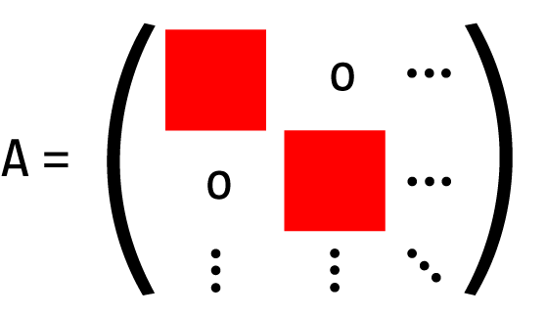
CONNECTIVITY OF UNDIRECTED GRAPHS Adjacency Matrix
The adjacency matrix of a network with several components can be written in a block-diagonal form, so that nonzero elements are confined to squares, with all other elements being zero:
Figure after Newman, 2010
Network Science: Graph Theory January 24, 2011

Slide 57
CONNECTIVITY OF DIRECTED GRAPHS
Strongly connected directed graph: has a path from each node to
every other node and vice versa (e.g. AB path and BA path).
Weakly connected directed graph: it is connected if we disregard the
edge directions.
Strongly connected components can be identified, but not every node is part
of a nontrivial strongly connected component.
B
E
A
B
F
A
D
E
C
D
C
G
F
G
In-component: nodes that can reach the scc,
Out-component: nodes that can be reached from the scc.
Network Science: Graph Theory January 24, 2011

Slide 58


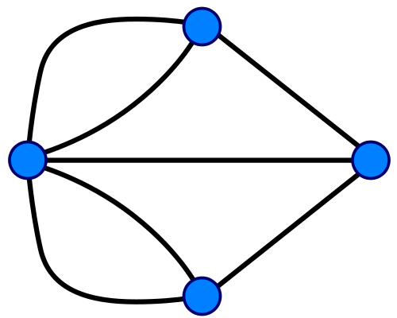
HISTORICAL DETOUR: THE BRIDGES OF KONIGSBERG
Can one walk across the seven bridges and never cross the same bridge twice?
Euler circuit: return to the starting point by traveling each link of the graph once and only once.
http://maps.google.com/maps?oe=utf-8&client=firefox-a&q=kaliningrad&ie=UTF8&hq=&hnear=Kaliningrad,+Kaliningrad+Oblast,+Russia&gl=us&ll=54.707293,20.510788&spn=0.009248,0.025878&t=h&z=15
Euler’s theorem:
(a) If a graph has nodes of odd degree, it cannot have an Euler circuit.
(b) If a graph is connected and has no odd degree nodes, it has at
least one Euler circuit.
How would we need to modify the graph so it has an Euler circuit?
Network Science: Graph Theory January 24, 2011
Notes:
The first graph theory paper was published in 1736, written by Leonhard Euler a Swiss born mathematician who spent his career in Berlin and St. Petersburg, and who had an extraordinary influence on all areas of mathematics, physics and engineering.
It addressed an amusing problem which originated in Königsberg, a town not too far from Euler’s home in St. Petersburg. Königsberg, a flowering city in Eastern Prussia, was a thriving city on the banks of the Pregel, with a busy fleet of ships and their trade offered a comfortable life to the local merchants and their families. The healthy economy allowed city officials to build not fewer than seven bridges across the river. Most of these connected the elegant island Kneiphof, which was caught between the two branches of the Pregel. Two additional bridges crossed the two branches of the river (Figure 1). The people of Königsberg, amused themselves with mind puzzles, one of which was: “Can one walk across the seven bridges and never cross the same one twice?” Euler offered a rigorous mathematical proof that with the seven bridges such a path does not exist.
Nevertheless, it is not the proof that made history, but rather the intermediate step that he took to solve the problem. Euler’s great insight decided to view Königsberg’s bridges as a graph, the collection of nodes connected by links. For this he used nodes to represent each of the four land areas separated by the river, distinguishing them with letters A, B, C, and D. Next he called the bridges the links, and connected with lines those pieces of land that had a bridge between them. He thus obtained a graph, whose nodes were pieces of land and links were bridges. Euler’s proof that in Königsberg there is no path crossing all seven bridges only once was based on a simple observation. Nodes with odd number of links must be either the starting or the end point of the journey. A continuous path that goes through all bridges can have only one starting and one end point. Thus, such a path cannot exist on a graph that has more than two nodes with an odd number of links. As the Königsberg graph had three such nodes, one could not find the desired path.
For our purpose the most important aspect of Euler’s proof is that the existence of the path does not depend on our ingenuity to find it. Rather, it is a property of the graph. Given the layout of the Königsberg bridges, no matter how smart we are, we will never succeed at finding the desired path. The people of Königsberg finally agreed with Euler, gave up their fruitless search and in 1875 they built a new bridge between B and C, increasing the number of links of these two nodes to four. Now only one node (D) with an odd number of links remained. It was then rather straightforward to find the desired path. Perhaps the creation of this path was the hidden rationale behind building the bridge? In retrospect, Euler’s unintended message is very simple: graphs or networks have properties, hidden in their construction, that limit or enhance our ability to do things with or on them.

Slide 59
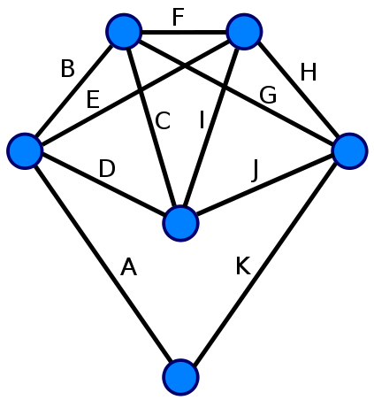
EULERIAN GRAPH
Every vertex of this graph has an even degree, therefore this is an Eulerian graph. Following the edges in alphabetical order gives an Eulerian circuit/cycle.
http://en.wikipedia.org/wiki/Euler_circuit
Network Science: Graph Theory January 24, 2011

Slide 60
EULER CIRCUITS IN DIRECTED GRAPHS
B
If a digraph is strongly connected and the in-degree of each node is equal to its out-degree, then there is an Euler circuit
D
A
C
E
Q: Give one possible Euler circuit
F
G
Otherwise there is no Euler circuit.
This is because in a circuit we need to enter each node as many times as we leave it.
Network Science: Graph Theory January 24, 2011

Slide 61
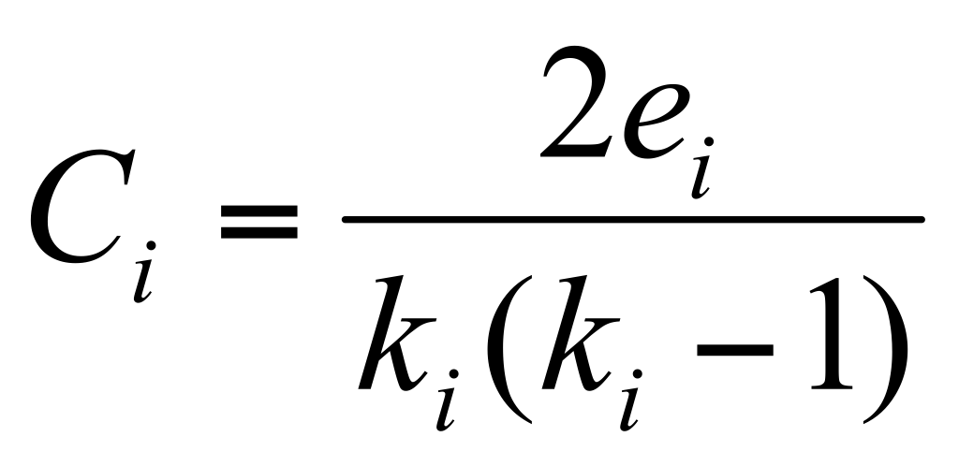
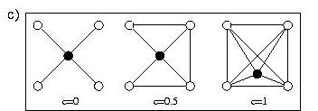
CLUSTERING COEFFICIENT
Clustering coefficient:
what portion of your neighbors are connected?
Node i with degree ki
Ci in [0,1]
Network Science: Graph Theory January 24, 2011

Slide 62
CLUSTERING COEFFICIENT
Clustering coefficient: what portion of your neighbors are connected?
Node i with degree ki
3
6
1
8
4
5
2
7
10
9
i=8: k₈=2, e₈=1, TOT=2*1/2=1 ➔ C₈=1/1=1
Network Science: Graph Theory January 24, 2011

Slide 63
CLUSTERING COEFFICIENT
Clustering coefficient: what portion of your neighbors are connected?
Node i with degree ki
3
6
1
8
4
5
2
7
10
9
i=4: k₄=4, e₄=2, TOTAL=4*3/2=6 ➔ C₄=2/6=1/3
Network Science: Graph Theory January 24, 2011

Slide 64
KEY MEASURES
Degree distribution: P(k)
Path length: l
Clustering coefficient:
Network Science: Graph Theory January 24, 2011

